Slide 1

Python
Programming with Python modes

Slide 2

Selection
Selection is how programs make choices, and it is the process of making choices that provides a lot of the power of computing
Python uses if-elif-else to handle selection with the code.

Slide 3
If Statement
if boolean expression :
suite
evaluate the boolean (True or False)
if True, execute all statements in the suite

Slide 4
Warning about indentation
Elements of the suite must all be indented the same number of spaces/tabs
Python only recognizes suites when they are indented the same distance (standard is 4 spaces)
You must be careful to get the indentation right to get suites right.

Slide 5
Python if-else
if boolean expression:
suite1
else:
suite2
The process is:
• evaluate the boolean
• if True, run suite1
• if False, run suite2
www.skillslash.com

Slide 6
Python if-elif-else
if boolean expression1:
suite1
elif boolean expression2:
Suite2
(as many elif's as you want)
else:
suite_last
www.skillslash.com

Slide 7
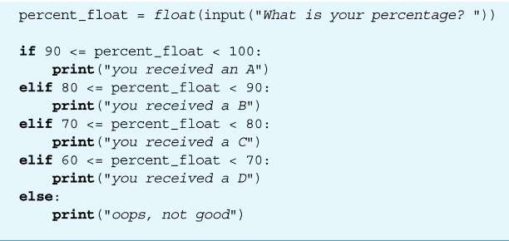
Sample Program
www.skillslash.com

Slide 8
Iteration/Repetition
Besides selecting which statements to execute, a fundamental need in a program is repetition
– repeat a set of statements under some conditions
With both selection and repetition, we have the two most necessary programming statements

Slide 9
While and For statements
The while statement is the more general repetition construct. It repeats a set of statements while some condition is True.
The for statement is useful for iteration, moving through all the elements of data structure, one at a time.

Slide 10
While loop
Top-tested loop (pretest)
– test the boolean before running
– test the boolean before each iteration of the loop
while boolean expression:
suite

Slide 11
for loop
One of Python's strength's is it's rich set of built-in data structures
The for statement iterates through each element of a collection (list, etc.)
for element in collection:
code block

Slide 12
range() and for loop
The range function represents a sequence of integers
the range function takes 3 arguments:
– the beginning of the range. Assumed to be 0 if not provided
– the end of the range, but not inclusive (up to but not including the number).
– the step of the range. Assumed to be 1 if not provided
if only one arg provided, assumed to be the end value

Slide 13
range() demo
for num in range(1,5):
print(num)
• range represents the sequence 1, 2, 3, 4
• for loop assigns num to each of the values in the sequence, one at a time, in sequence
• prints each number (one number per line)

Slide 14
THANK YOU
www.skillslash.com

